Slide 1
Jaipur Restaurant Analysis
Rohit Kumar Bindal

Slide 2


Why Jaipur Restaurants only?
Well, for starters, I live in Jaipur and also the food culture of Jaipur is quite fascinating. One can find almost all the major players in the restaurant business in Jaipur apart from a few exceptions like Starbucks.
Currently the approximate count of restaurants in Jaipur stands at around 4500, with an industry that hasn’t saturated yet, this number increases day by day. The aim of this project is to analyze the demography and food culture of a locality in Jaipur.
It might help new restaurants decide their theme, menus, cuisines, cost and other features to serve better in its locality.

Slide 3
Data Acquisition and Cleaning
The data used for this project has been extracted from two sources:
The Restaurants in a locality were scraped from Zomato Website.
Exploring trending venues in a locality, particularly restaurants, art or entertainment venues like a Cinema or Museum, using the Foursquare API.
In total, 4,700 rows and 8 features were extracted in the raw dataset.
Records with no geographical coordinates were dropped.
The Categories and Cuisines were converted into a more readable format.

Slide 4

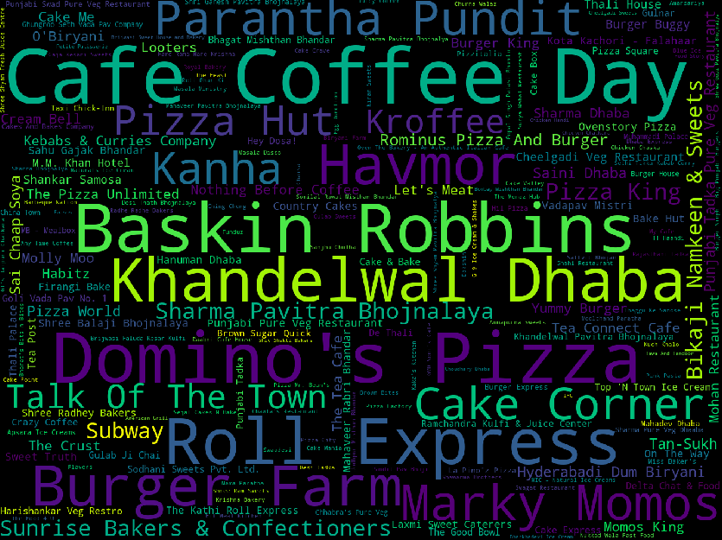
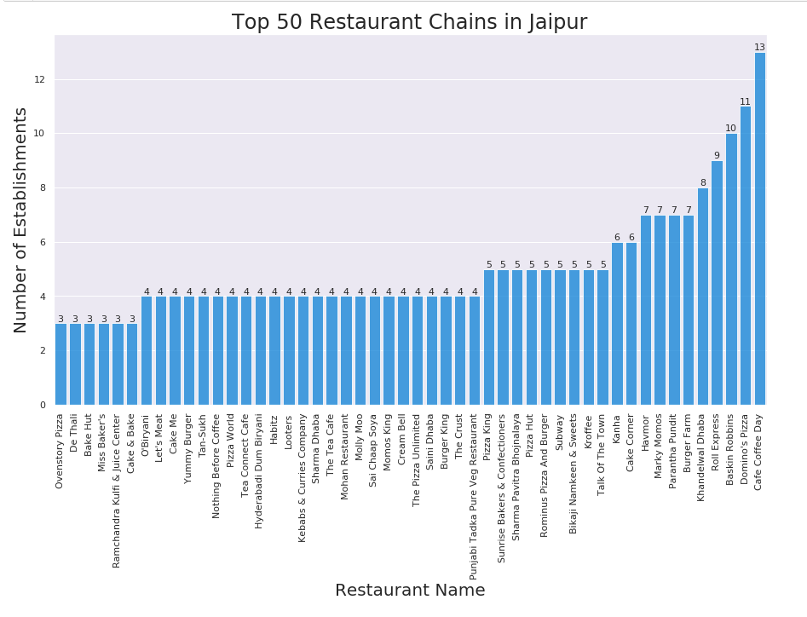


Number of Food chains in Jaipur

Slide 5
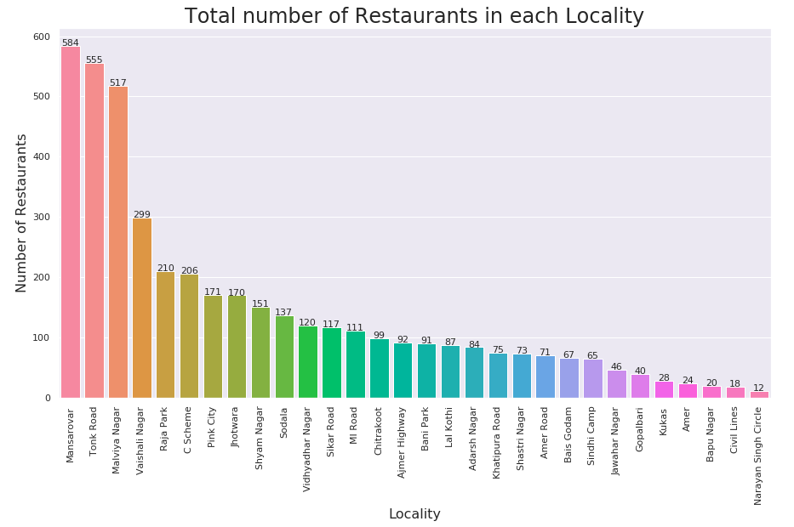
Number of Restaurants in each locality

Slide 6
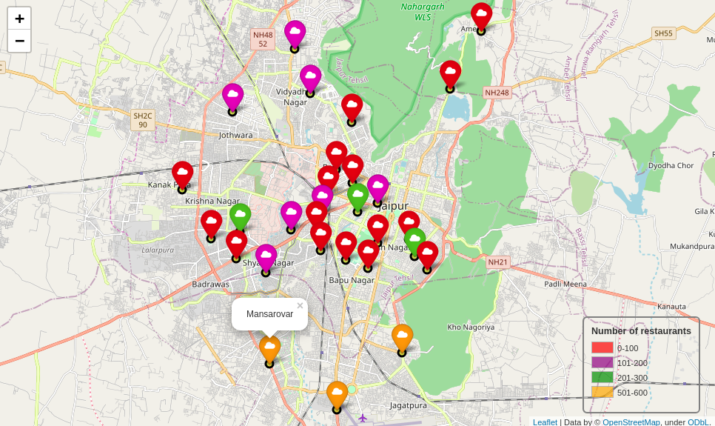
Central Jaipur is densely populated

Slide 7
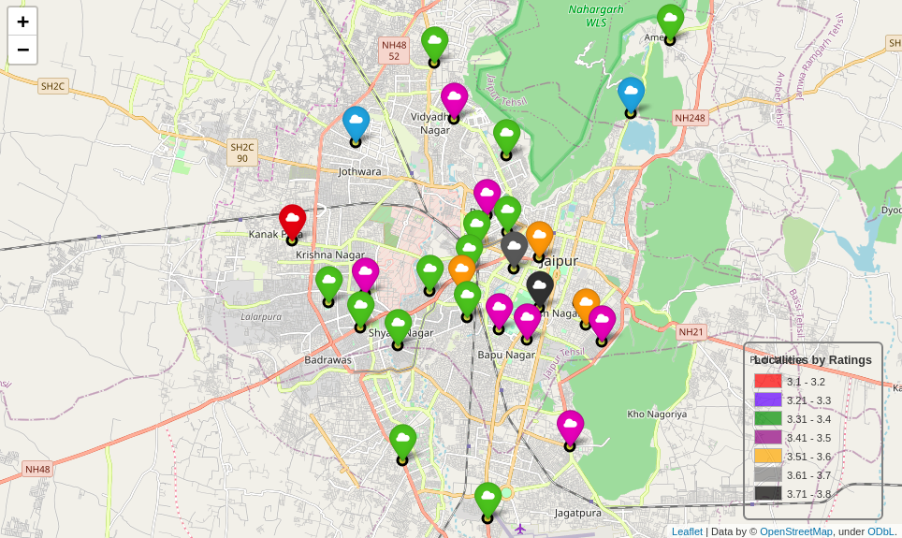
Top rated restaurants are also clustered around central Jaipur

Slide 8
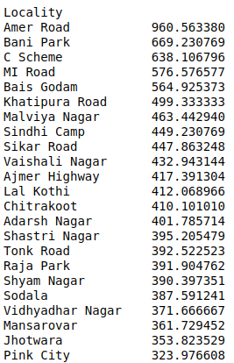
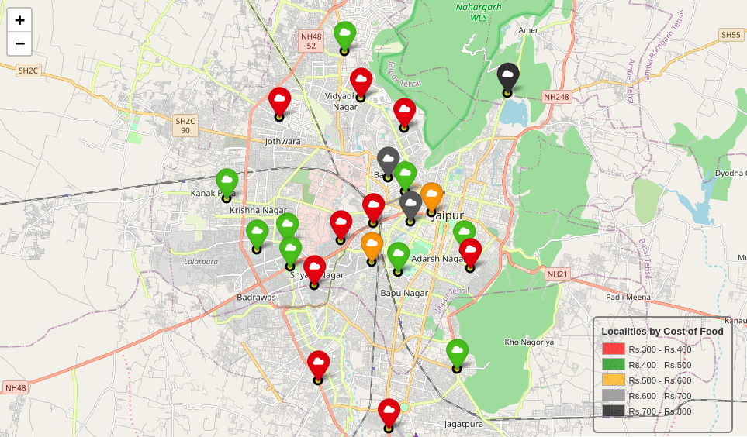
Average cost of food in each Locality.

Slide 9
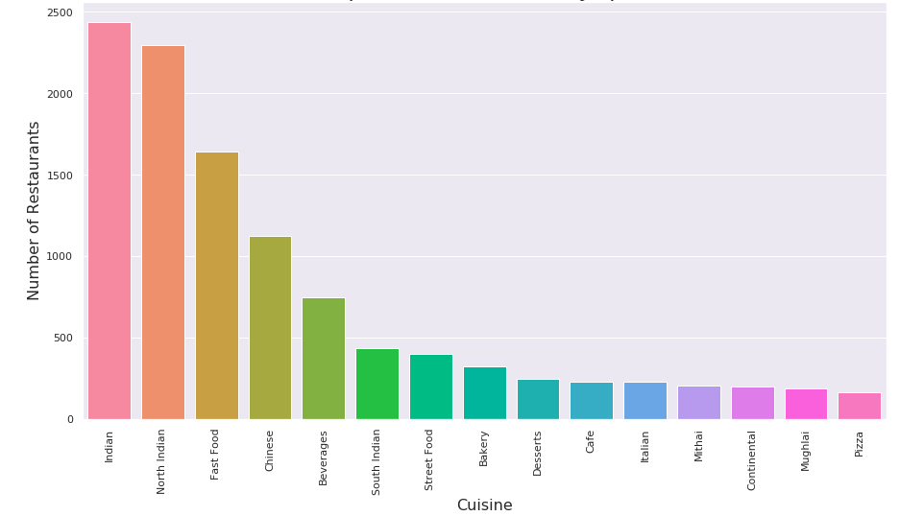
Top 15 cuisines in Jaipur

Slide 10
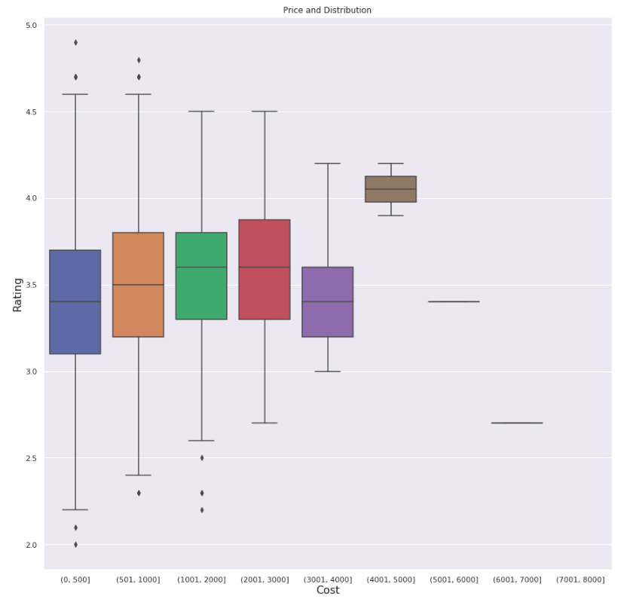
Price range and ratings

Slide 11
Higher rated restaurants have more number of Cuisines
Through further analysis, it was found that Asian, Mexican, Italian, Lebanese, Hyderabadi, European, Continental, South Indian, American, Desserts, Finger Food were the highest rated cuisines. Though North Indian, Chinese, Mughlai, Rajasthani were the top rated, but that was obvious since Jaipur lies in the Northern Region of India.

Slide 12
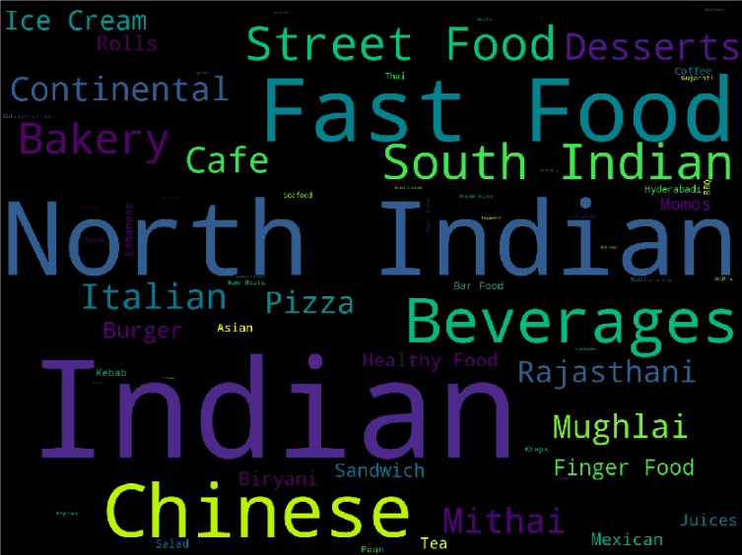
Famous Cuisines in Jaipur

Slide 13
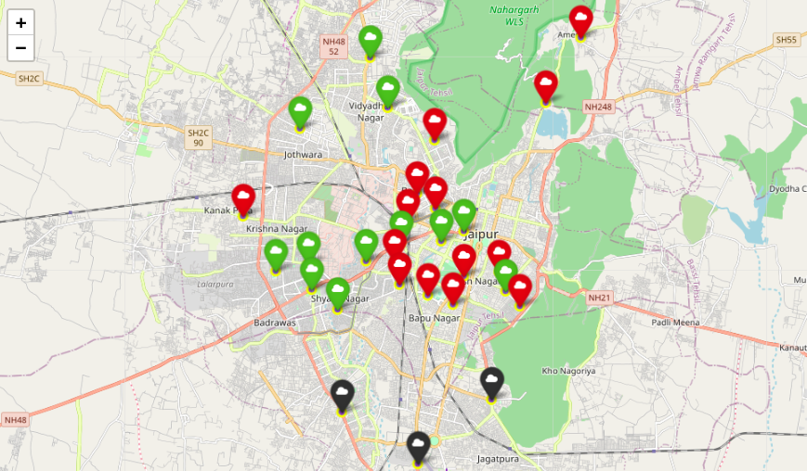
K-Means Clustering based on Cuisines
Cluster 1 (Red) are the places that are more famous for their North Indian, South Indian and Chinese cuisines.
Cluster 2 (Black) are the places that are famous for North Indian cuisine, Italian cuisine and Fast Food.
Cluster 3 (Green) are the places known for the Mexican, Mediterranean, Continental, Japanese food.

Slide 14
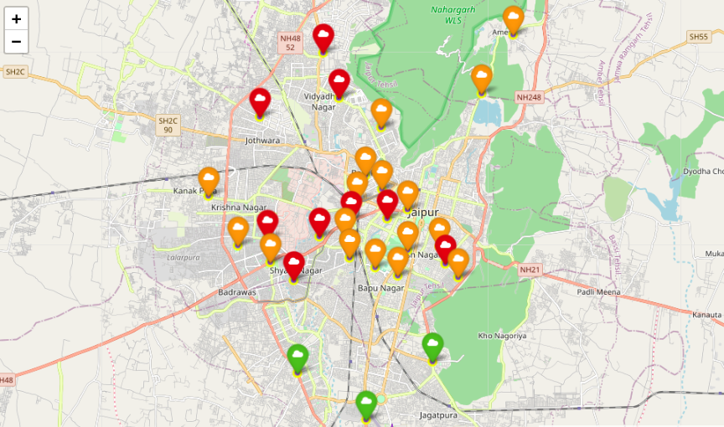
K-Means Clustering based on Restaurant Types.
Cluster 1(Red) are the places with more traditional eating offerings, bars, Quick Bites.
Cluster 2(Orange) are the places known for the various sophisticated dining offerings, mainly Fine Dining restaurants and cafes.
Cluster 3(Green) are the places known for their fast-paced eating habit, Quick Bites and the Nightlife.

Slide 15
Conclusion and Future Directions
Quick service restaurants are a mainstay of the Indian food service market, and are growing fast. Fine dining is gaining prominence too. Both multi-cuisine and single-cuisine establishments have show tremendous growth.
The model and the idea can be used in real life if I get the access to the ordering data of Zomato. Telling certainly about entire neighborhood which is large is not possible. But the taste of a locality can be found out by their ordering pattern and the type of restaurant it houses.
The data can also be used to ﬁnd out the popular food, type of people, residency area etc. to help new restaurants take better data driven decisions.

